Slide 1
Rights and Freedoms
Year 10

Slide 2
IMPORTANT
Please not that some of the topics we will discuss are culturally sensitive and may be upsetting. But by learning about them we can ensure the atrocities of the past are not repeated and aim to achieve peace and harmony in our society. Please be respectful and understanding.

Slide 3
Learning Intentions for the Unit
Students investigate struggles for human rights in depth. This will include how rights and freedoms have been ignored, demanded or achieved in Australia and in the broader world context.
The origins and significance of the Universal Declaration of Human Rights, including Australia’s involvement in the development of the declaration
Background to the struggle of Aboriginal and Torres Strait Islander Peoples for rights and freedoms before 1965, including the 1938 Day of Mourning and the Stolen Generations
The US civil rights movement and its influence on Australia
The significance of the following for the civil rights of Aboriginal and Torres Strait Islander Peoples: 1962 right to vote federally; 1967 Referendum; Reconciliation; Mabo decision; Bringing Them Home Report (the Stolen Generations), the Apology
Methods used by civil rights activists to achieve change for Aboriginal and Torres Strait Islander Peoples, and the role of ONE individual or group in the struggle
The continuing nature of efforts to secure civil rights and freedoms in Australia and throughout the world, such as the Declaration on the Rights of Indigenous Peoples (2007)

Slide 4
Learning Intentions
To discover how Indigenous peoples in Australia struggled for rights and freedoms.
Success Criteria
I can discuss how Indigenous peoples in Australia struggled for rights and freedoms.

Slide 5
KEY QUESTION
How have Indigenous peoples in Australia struggled for rights and freedoms?

Slide 6
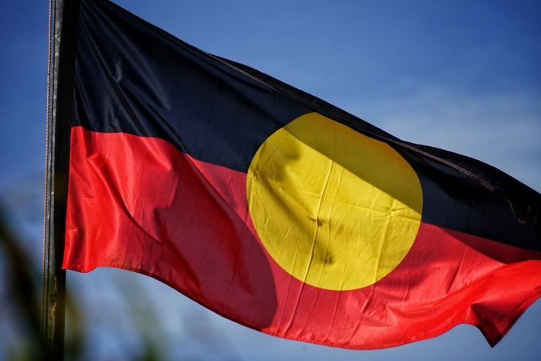
INDIGENOUS RIGHTS

Slide 7
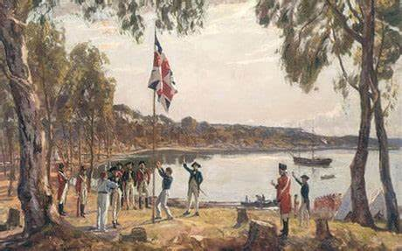
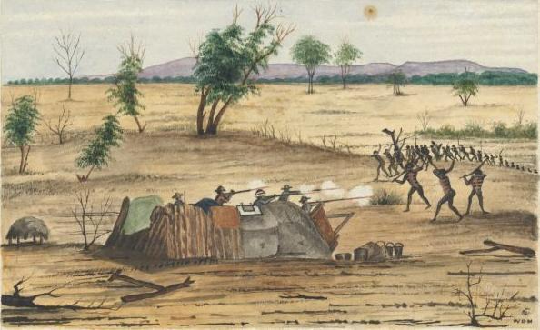
British Settlement
When British explorers and settlers arrived on the east coast of Australia in 1788, they did not understand the Indigenous population. The British looked for signs of permanent residence, and could find none, so they didn’t negotiate any treaties. They also looked for evidence of farming, and could find none, so they proclaimed Australia terra nullius – a Latin term that literally translates as ‘nobody’s land’.

Slide 8
The negative effects of European settlement on Indigenous Australians
The expansion of British colonial settlements into established Aboriginal lands destroyed traditional ways of life.
High numbers of Indigenous Australian premature deaths were the result of violence and disease.
By the time of Federation in 1901, European settlements dominated most of the continent. Aboriginal and Torres Strait Islander cultures were not officially recognised.
Public policy was dominated by ideas of segregation (separating blacks from whites) and assimilation (integrating blacks into white society).
Both of these ideas were based on the assumption that Aboriginal people were inferior to Europeans.

Slide 9
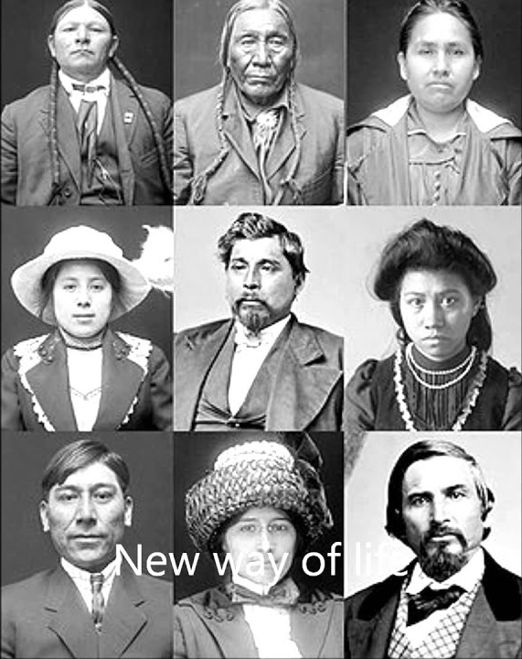
Assimilation Policy
Officially adopted in 1937.
Aboriginal people of mixed race were to be assimilated into white society whether they wanted to be or not.
If these people were not going to simply ‘die out’ then all efforts should be directed to ensuring that mixed-race Aboriginal people could be integrated.

Slide 10
The Stolen Generations
From the late 1800s to the 1970s many thousands of Aboriginal children were forcibly removed from their families and placed into state care or placed with white families.
These children, now referred to as the Stolen Generations, faced ongoing emotional and social difficulties because of their removal from their families.
In most states, it was believed that if mixed-race Aboriginal children could be brought up in a ‘white’ community, their Aboriginality could be overcome and their ‘white’ attributes would shine through. These children were taken from their families and raised in missions or with white families.

Slide 11
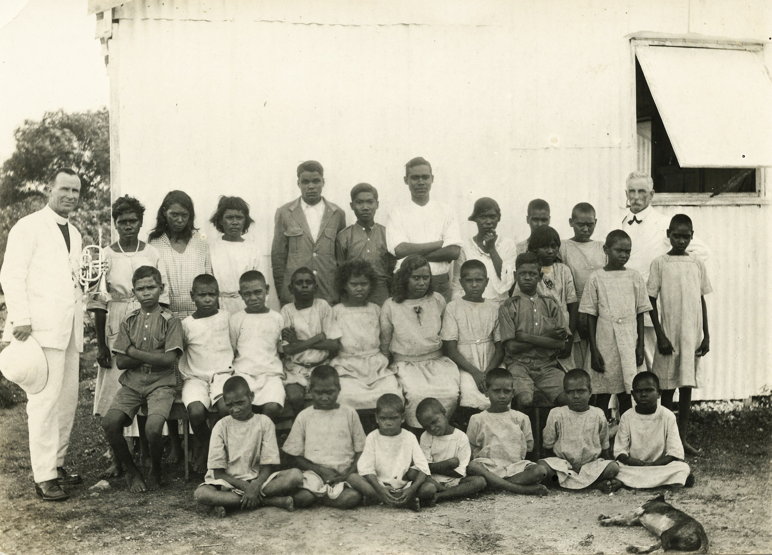

Slide 12
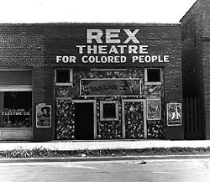
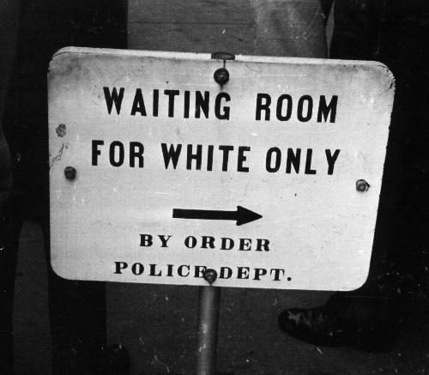
Segregation
Another effective means of controlling Aboriginal and Torres Strait Islander people was to prevent them from fully participating in society.
‘Colour bars’ – bans that prevented Aboriginal people from entering clubs, restaurants, public swimming pools or using public transport etc.
Aboriginal people were banned from working particular jobs and expected to work for less money.
Separate sections in theatres, separate wards in hospitals, and denial of school enrolment to Aboriginal children were common.
The practice of segregation continued until the 1960s.

Slide 13
Indigenous protests during the 19th and 20th centuries
Despite the many discriminatory policies of Australian colonial and state governments in the late 19th and early 20th centuries, Indigenous Australians made repeated attempts to have their traditions and rights recognised.
Many of the people who would go on to become important figures in the struggle for Indigenous civil rights came from the Aboriginal reserves and missions that had been set up by Aboriginal Protection Boards.

Slide 14
KEY QUESTION
How have Indigenous peoples in Australia struggled for rights and freedoms?

Slide 15
Learning Intentions
To discover how Indigenous peoples in Australia struggled for rights and freedoms.
To begin exploring the US Civil Rights Movement.
Success Criteria
I can discuss how Indigenous peoples in Australia struggled for rights and freedoms.
I can briefly discuss the US Civil Rights Movement.

Slide 16
KEY QUESTION
How have Indigenous peoples in Australia struggled for rights and freedoms?

Slide 17
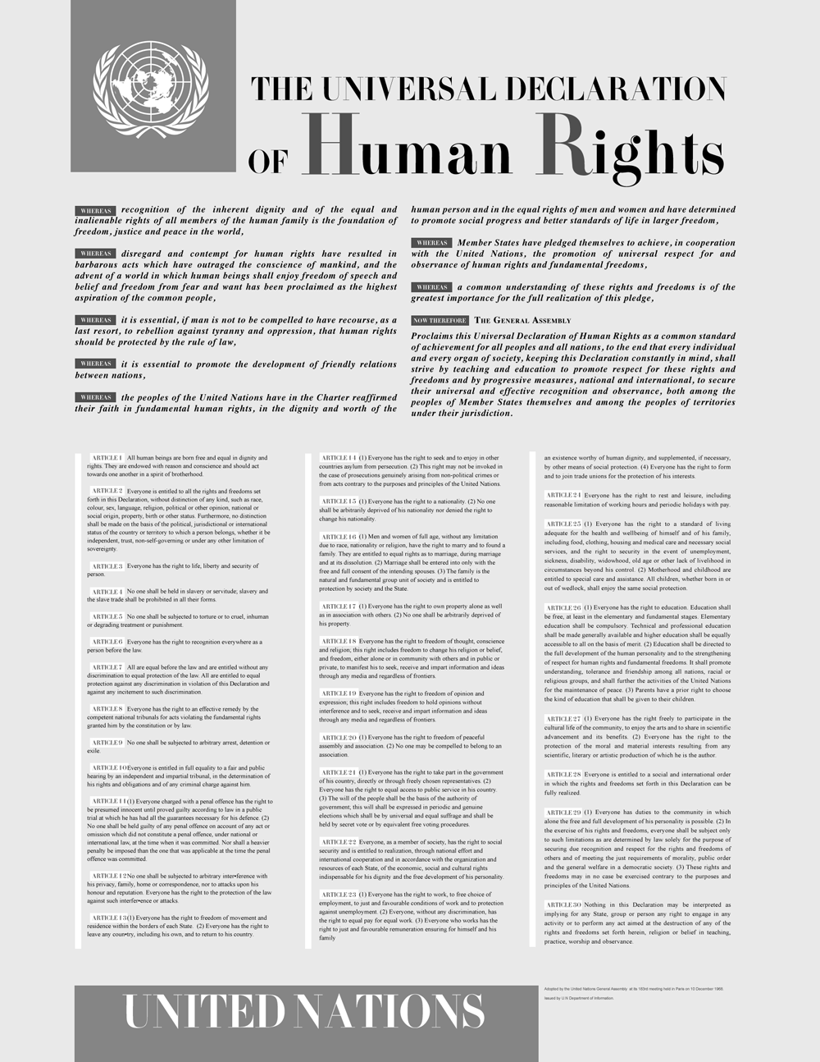
The Universal Declaration of Human Rights
It was only until after Australia’s championing of the Universal Declaration of Human Rights in 1948 that attention gradually turned towards the situation and status of Aboriginal and Torres Strait Islander peoples.

Slide 18
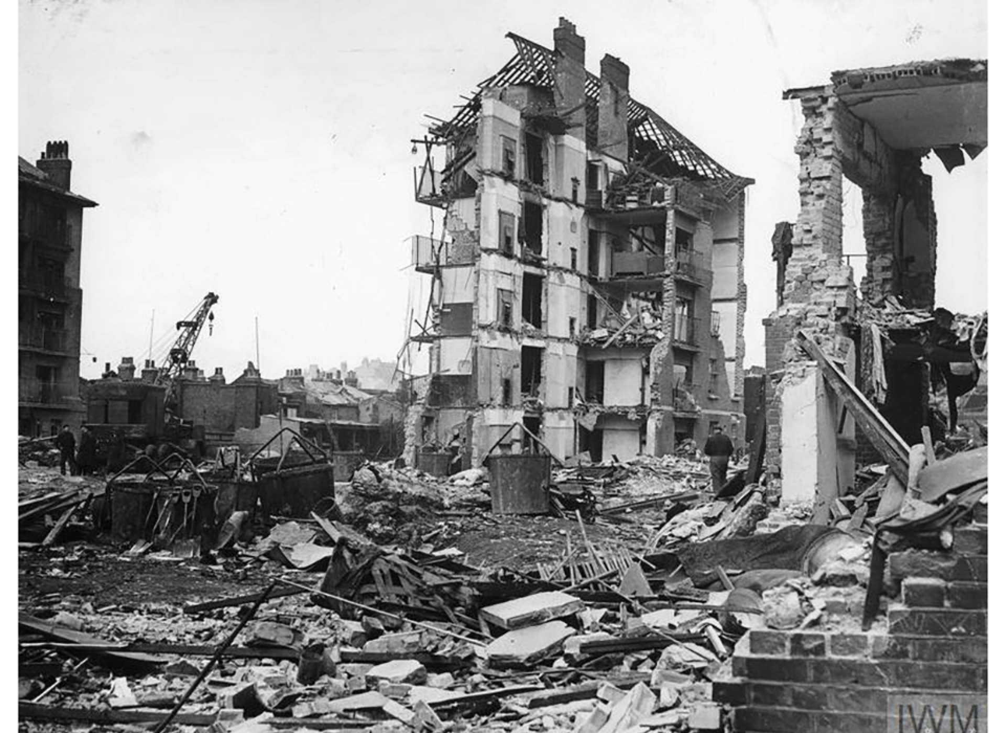
The Legacy of WWII
Millions of people were massacred during World War II. Many millions more never saw their families or homes again as a result of the destruction.
During the war, many world leaders started to develop an ambitious, global response to these atrocities.

Slide 19

The Legacy of WWII
Immediately after the end of World War II, the United Nations was formed and work started on formalising a set of basic human rights.
Part of this work involved establishing a set of international laws and treaties to protect people.

Slide 20
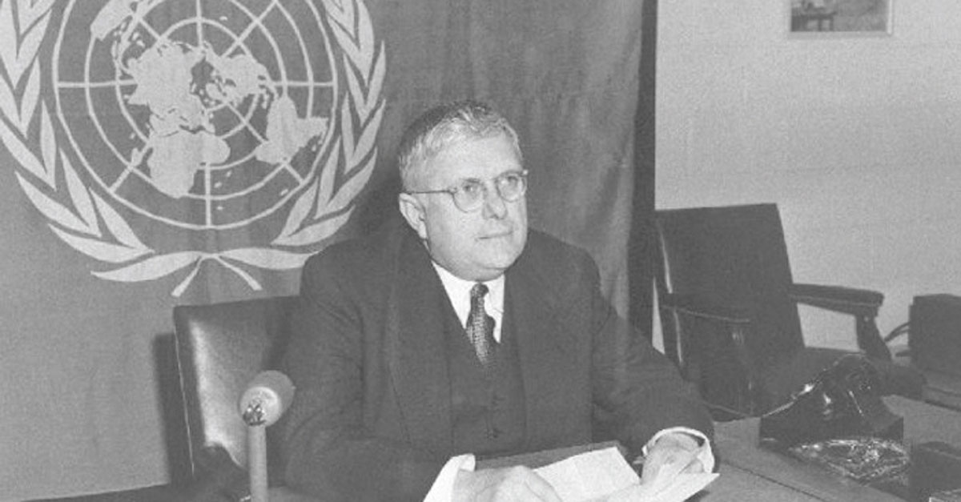
Australia’s Role
Australia’s Attorney-General, Herbert ‘Doc’ Evatt convinced traditional powers such as Britain and France that the General Assembly must be seen to take a leading role in the development of laws to protect human rights.
Evatt was General Secretary of the United Nations in 1948 and 1949, during which time he led the drafting of the Universal Declaration of Human Rights.

Slide 21
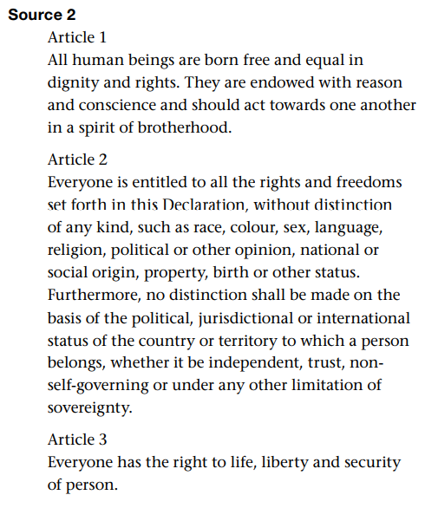
The Universal Declaration of Human Rights
This landmark document has 30 articles and has informed many international and national treaties and agreements relating to rights.
Most significantly, the declaration held that human rights are inalienable – meaning that they cannot be taken away from any one of us regardless of age, race, gender, religion, language or nationality

Slide 22
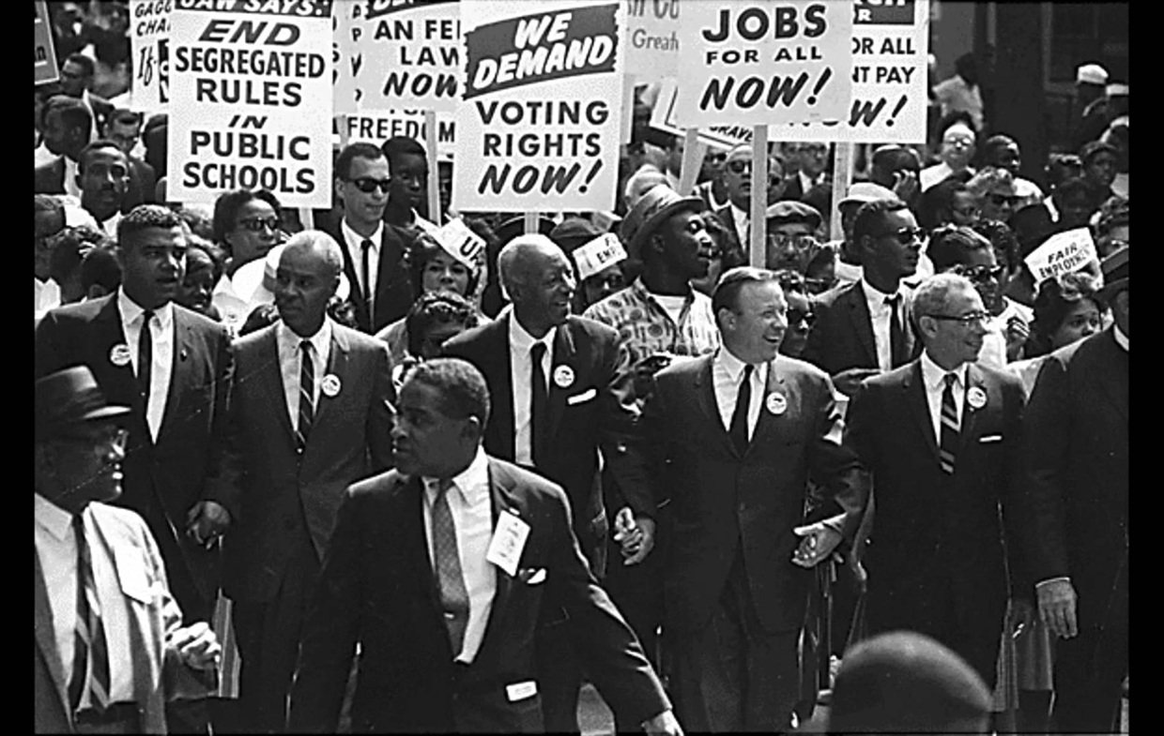
The Start of Civil Rights
Many historians argue that the Universal Declaration of Human Rights set the scene for the civil rights struggles that would take place around the world in the coming decades.

Slide 23
KEY QUESTION
How have African Americans and Indigenous peoples in Australia achieved change?

Slide 24
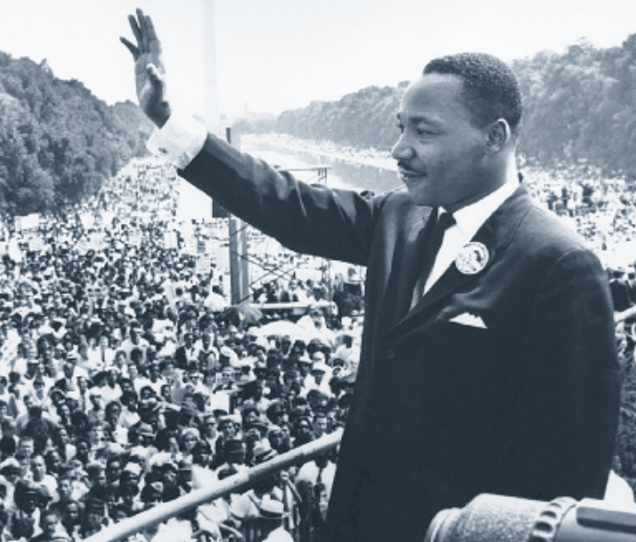
THE U.S. CIVIL RIGHTS MOVEMENT
During the 1960s, the struggle for civil rights for African Americans gained worldwide attention. A series of events and significant individuals in the US civil rights movement would go on to inspire and influence civil rights campaigners in Australia. We will now explore some of these key events.
Martin Luther King Jr.

Slide 25
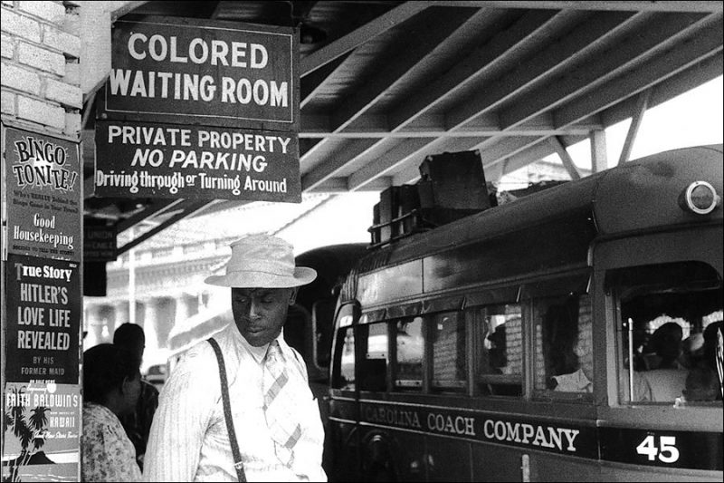
Segregation in America
In the southern states, segregation of the races had been legally enforced since the American Civil War ended in 1865.

Slide 26
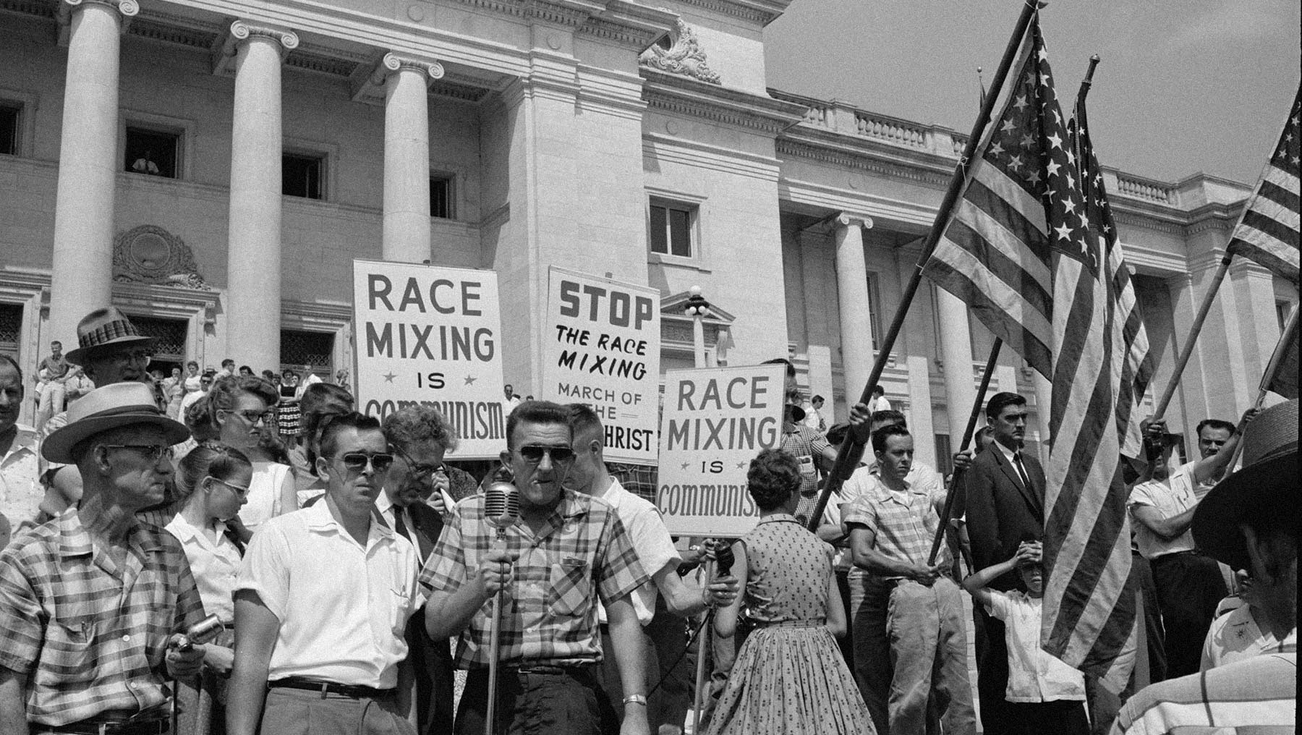

Slide 27
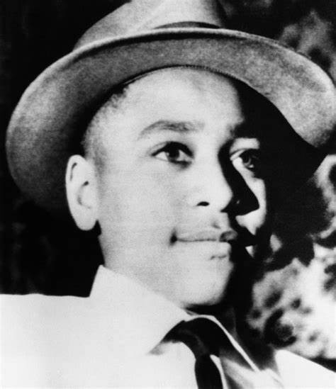
The Case of Emmett Till
In August 1955, a 14-year-old African-American boy called Emmett Till was murdered near the town of Money in Mississippi.
He had been brutally beaten and shot after being accused of flirting with a white woman.
His body was dumped in the Tallahatchie River. Before the funeral in his home city of Chicago, Till’s mother displayed his body in an open casket. She wanted the world to see the brutality of his murder.
The white men accused of his murder were found not guilty in a trial conducted before an all-white jury in Mississippi.

Slide 28
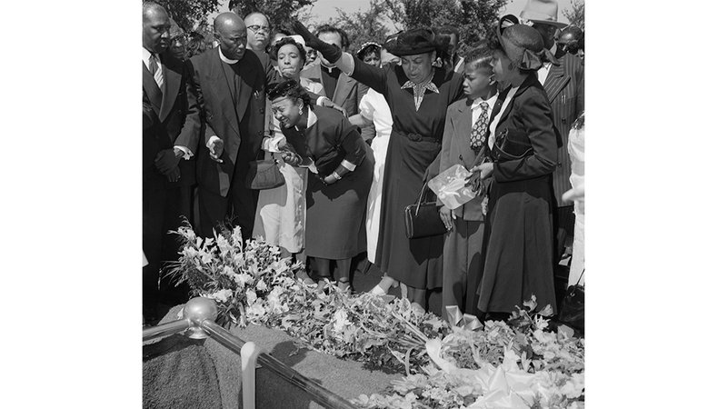
Emmett Till’s mum at his funeral

Slide 29
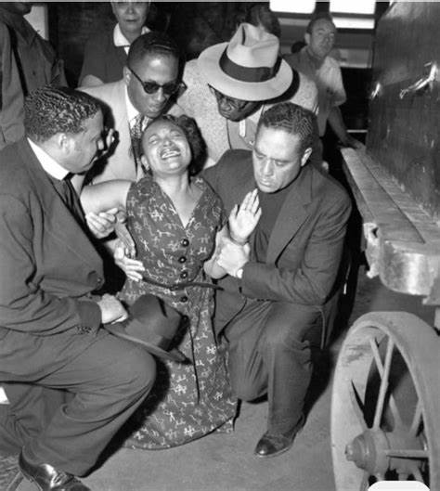
Emmett Till Continued
The two men charged later admitted to the murder in a magazine interview, knowing they could not be tried twice for the same crime.
The death of Emmett Till became a major turning point for the civil rights movement.
The 1957 Civil Rights Act came from the momentum generated by the Emmett Till case.

Slide 30
1957 Civil Rights Act
(11) Bob Dylan - The Death of Emmett Till (lyrics) - YouTube
The Act aimed to ensure that all African Americans could exercise their right to vote, as well as providing resources for ongoing monitoring of civil rights abuses. It also called for a government report on race relations.
The Emmett Till case became a symbol for the civil rights movement across the United States. Authors used the case in many books to challenge public racism, and in 1962 the famous musician Bob Dylan recorded a song called 'The Death of Emmett Till'. Till’s death was a tragedy that inspired thousands to change American society

Slide 31
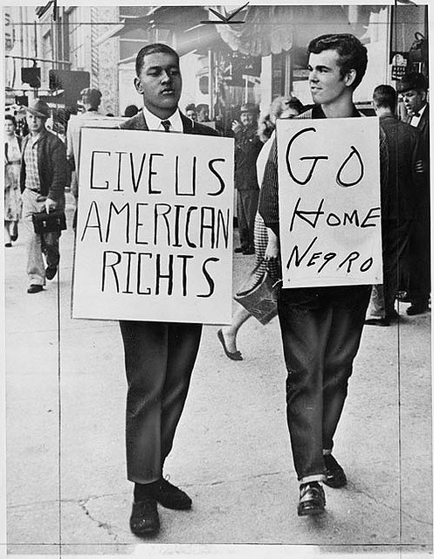
Boycotts
At roughly the same time, African Americans across the country began to assert their demands for equality in a number of different ways.

Slide 32
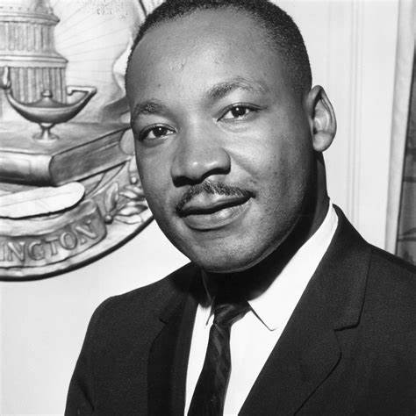
Martin Luther King Jr.
In 1963, King led the March on Washington, which was attended by 250000 people, many of whom demanded an end to segregation.
King redefined the rights movement.
While the US Supreme Court had delivered a legal plan for desegregation, King’s famous ‘I have a dream’ speech delivered at the March on Washington was a moral plan for change.
https://www.youtube.com/watch?v=vP4iY1TtS3s

Slide 33
Martin Luther King Jr. Continued
After President Kennedy’s assassination in November 1963, President Lyndon Johnson accepted the challenge that Martin Luther King Jnr’s success had created. On 2 July 1964, the US Congress enacted the Civil Rights Act, which outlawed discrimination based on race or gender. It was landmark legislation, but the challenge of changing racist attitudes among members of the general public still remained.

Slide 34
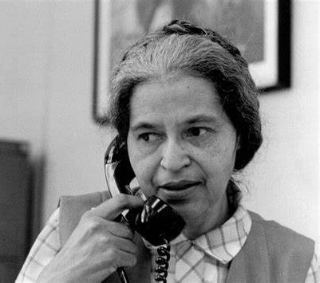
Rosa Parks
In 1955, Rosa Parks was arrested in Montgomery, Alabama, after refusing to give up her seat at the front of a bus for a white passenger. The arrest resulted in a boycott of the Montgomery bus service by African-American passengers, beginning in December 1955.
One year later, the boycott ended when the City of Montgomery was ordered by the US Supreme Court to stop segregating black and white passengers on its bus services.
This victory inspired further efforts to end segregation in America.

Slide 35
Rosa Parks
https://www.youtube.com/watch?v=v8A9gvb5Fh0

Slide 36
Learning Intentions
To discover how Indigenous peoples in Australia struggled for rights and freedoms.
Success Criteria
I can discuss how Indigenous peoples in Australia struggled for rights and freedoms.

